Slide 1
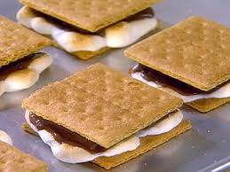
S’mores
Group 12:
Arjun Dave
William Lu
Susanna Pesonen
Nisha Subramanian
Brian Tam
Rachel Thomasson

Slide 2
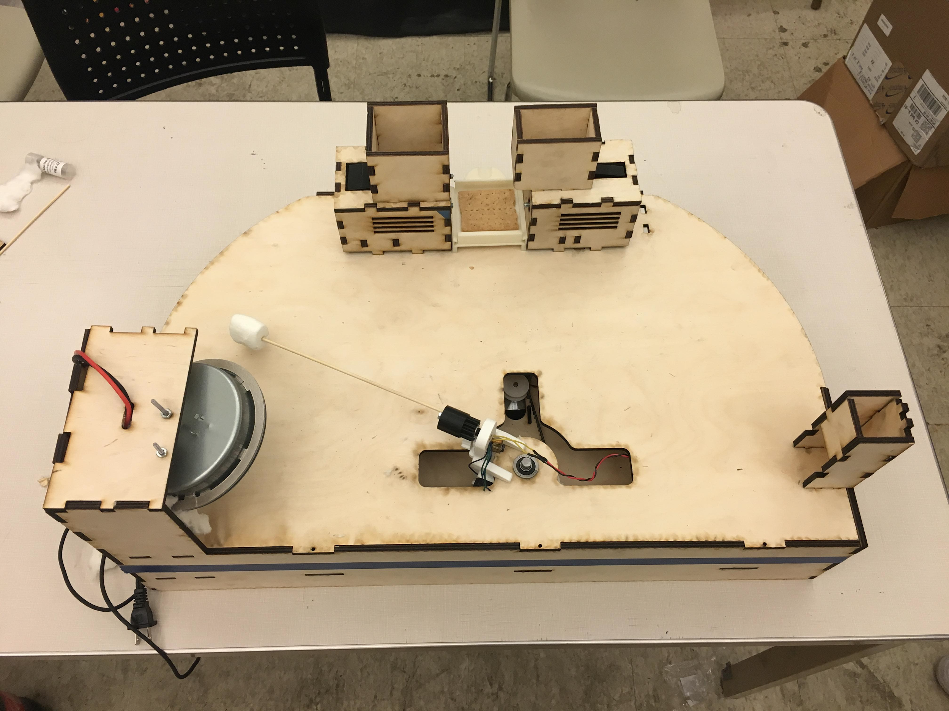
Objective
Create an automated s’more assembly machine which requires as little user intervention as possible

Slide 3
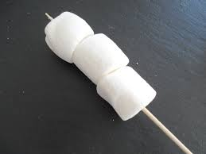
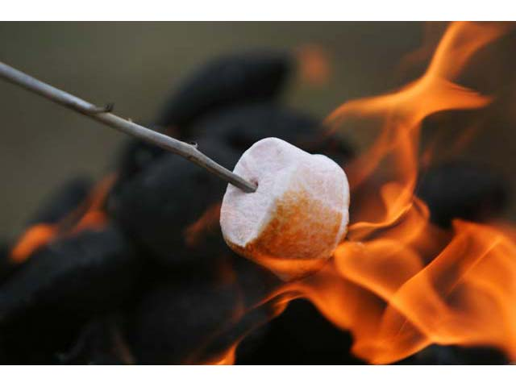
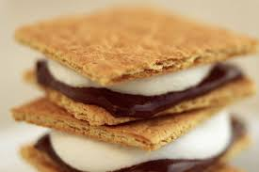
Mechanism
Skewer
3 Degrees-of-Freedom
Stepper Motors + Belt and Gear Drive
Heating Element
Electrical coil
Safety, cleanliness, and power
Assembly Mechanism
Rotating paddle to push food components
1 Degree-of-Freedom
Stepper Motor

Slide 4
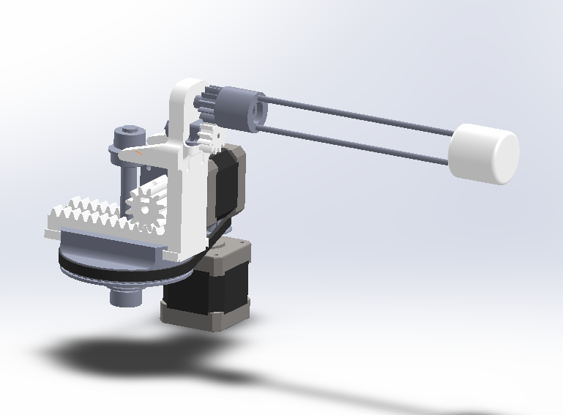
Skewer
Used to skewer marshmallow for toasting and move to final assembly plate
3 Degrees of Freedom
Nema-17 Stepper motors
Belt drive
Rack and pinion
Polulu micro motor

Slide 5
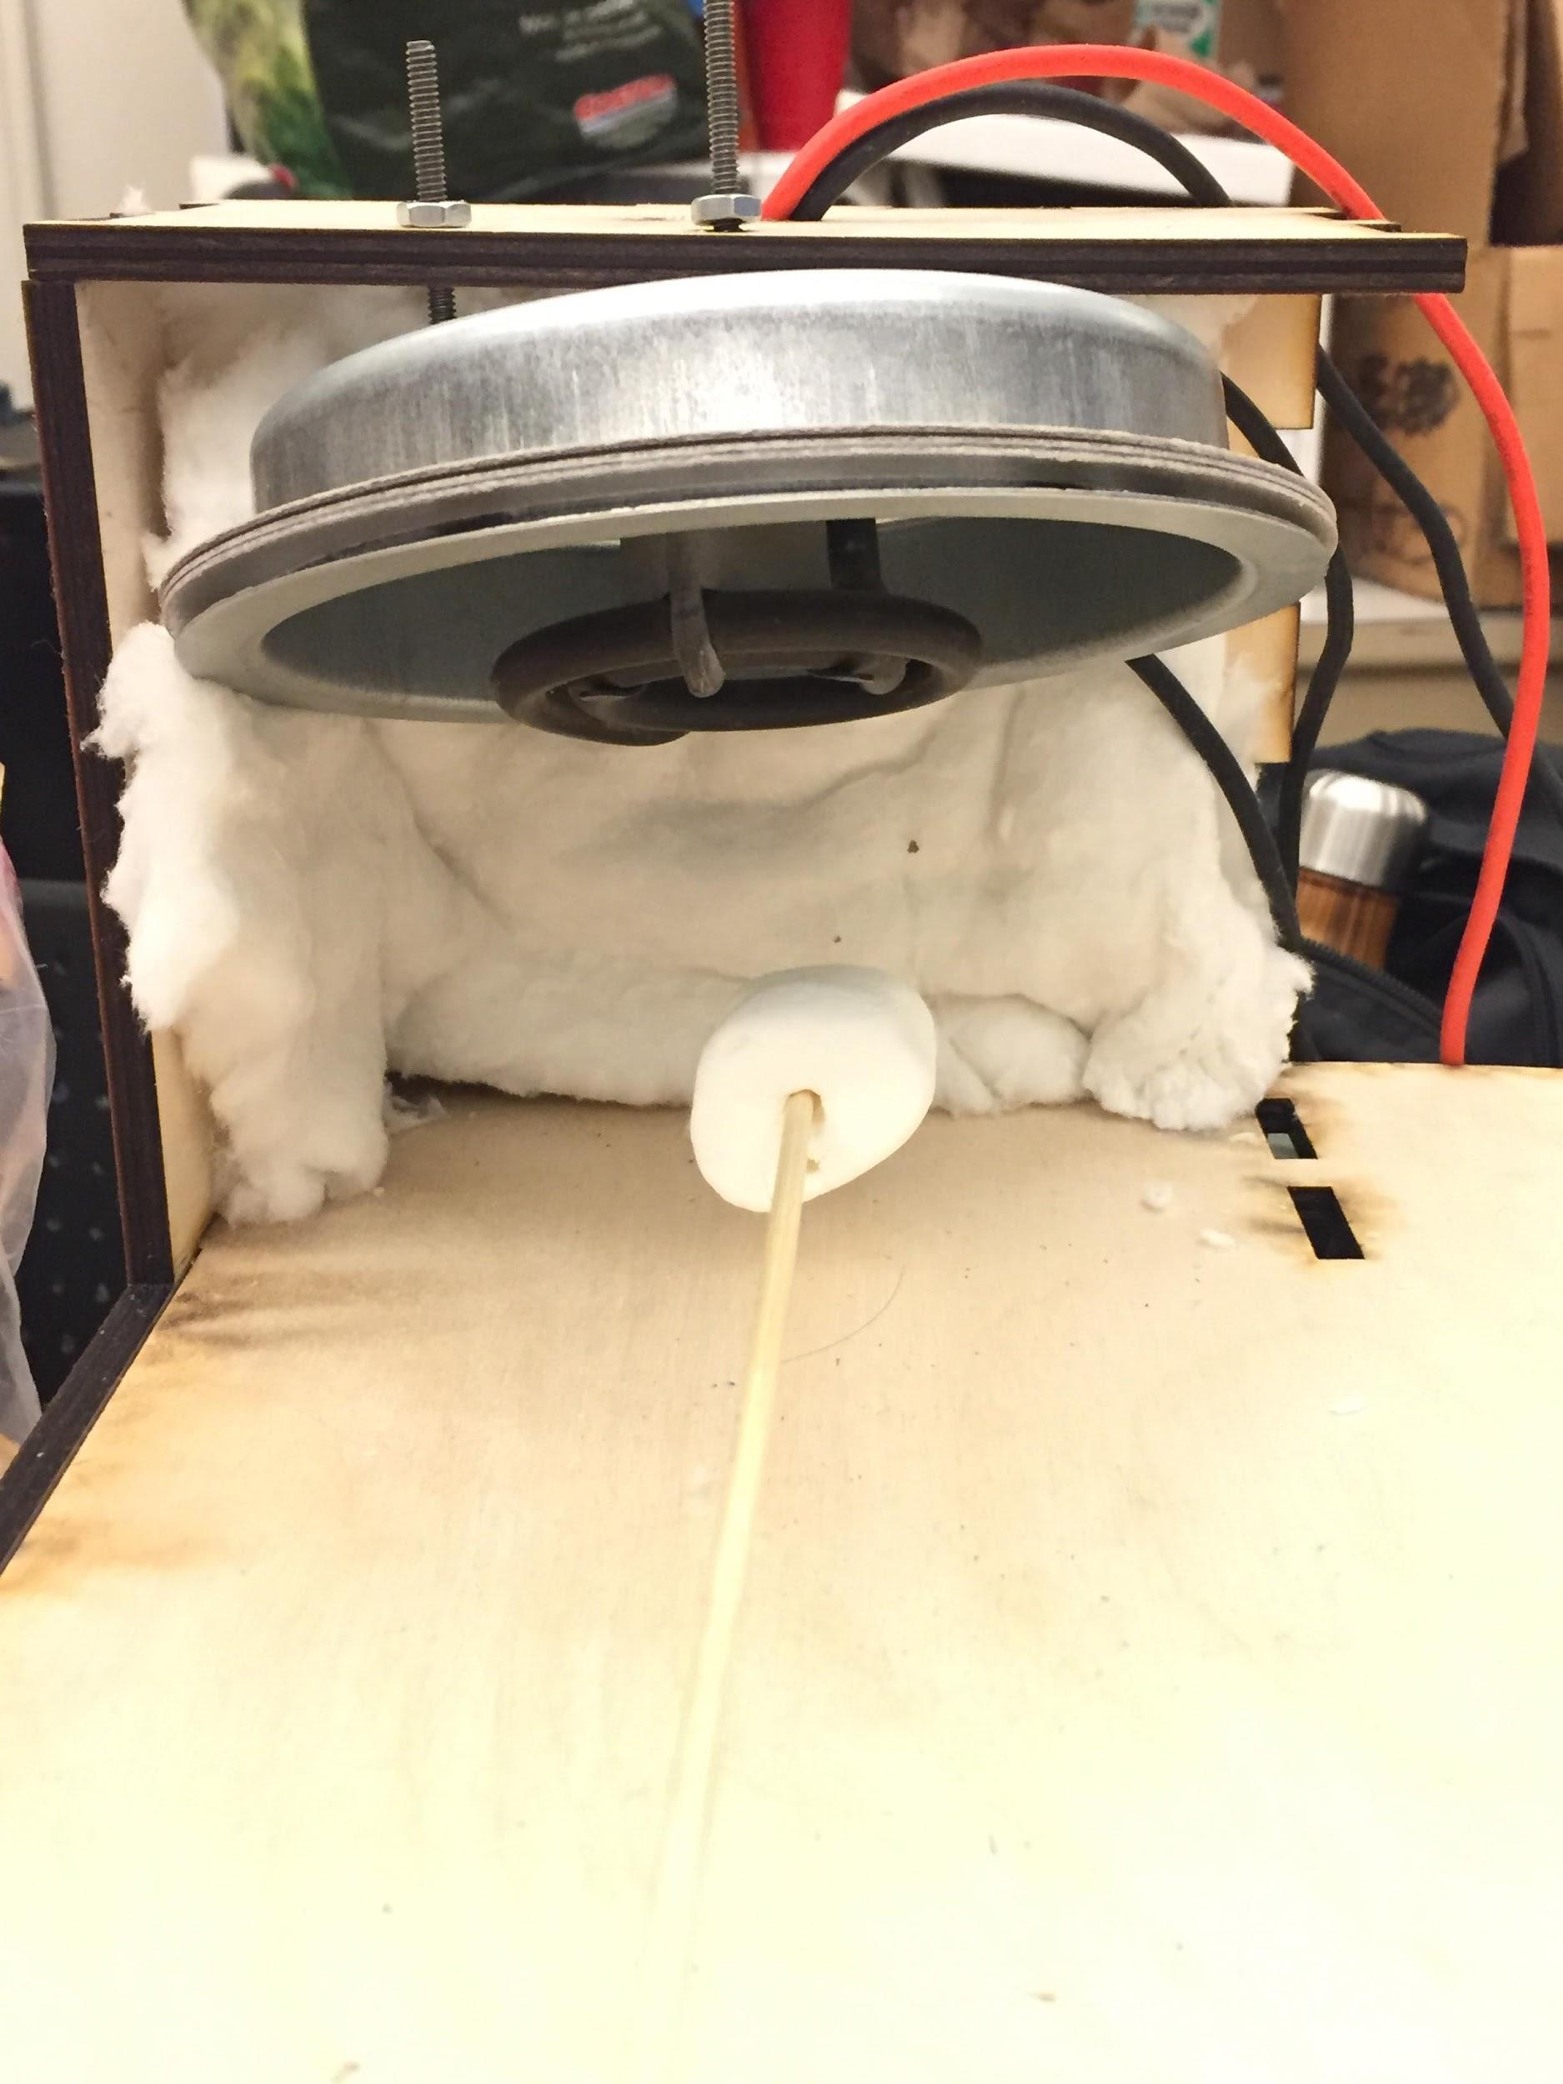
Heating Element
Electric Coil
Custom, smaller heating coil for marshmallow toaster
Wool for insulation
Fan cooling agent to promote forced convection

Slide 6
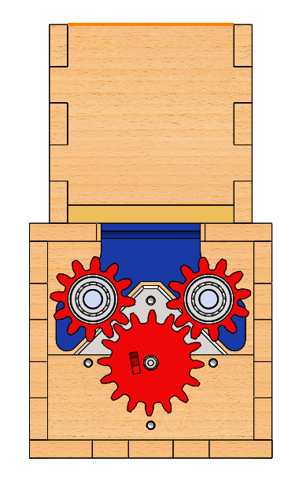
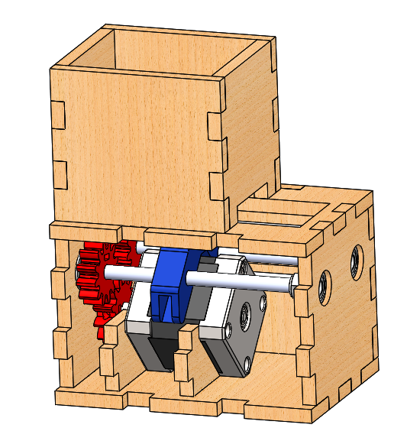
Cracker & Chocolate Assembly
Compact linear actuator
Nema-17 stepper motors
Lead Screw mechanism

Slide 7
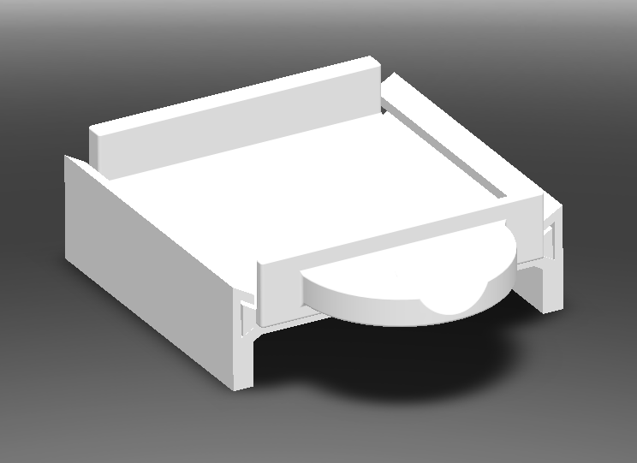
S’mores Removal

